Slide 1

SQL Spatial Geographical Data Analysis using Earthquake Data from USGS.GOV
Comprehensive Analysis and Visualizations
by
Sunita Inderjit

Slide 2
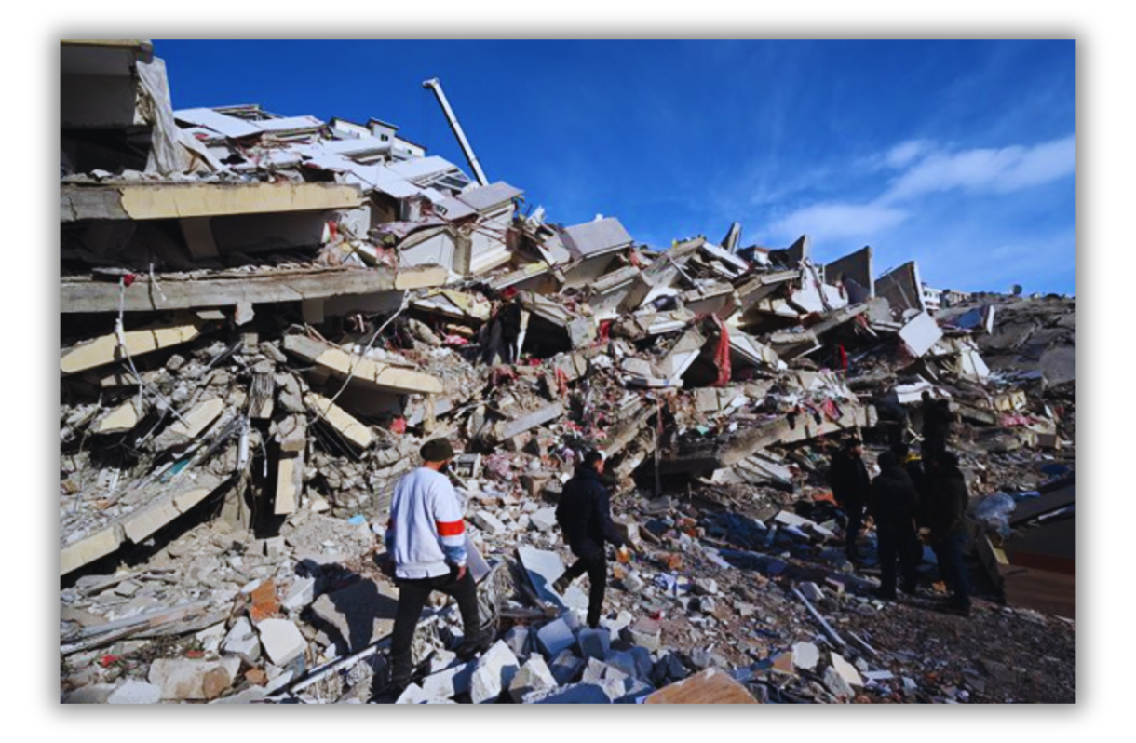
Business Problem
Identifying High-Risk Areas for Earthquake Preparedness and Resource Allocation

Slide 3

Objective
The goal is to analyze earthquake data to identify geographical regions with high seismic activity. This information can help governments, emergency response teams, and insurance companies to prioritize and allocate resources effectively, plan for disaster preparedness, and develop risk mitigation strategies

Slide 4
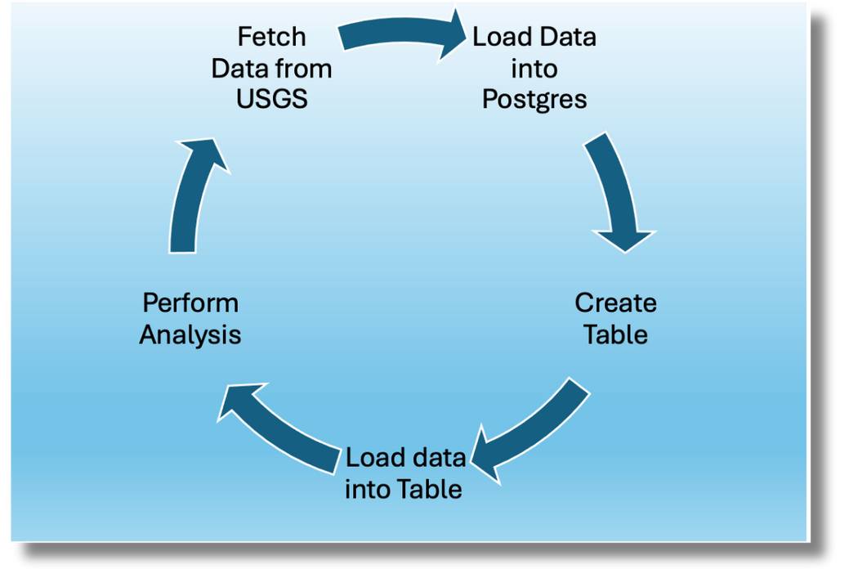
Data Connection and Integration
Data Formate CSV, consisted of 22 columns and 7884 rows
Year 2023 July to 2024 August

Slide 5
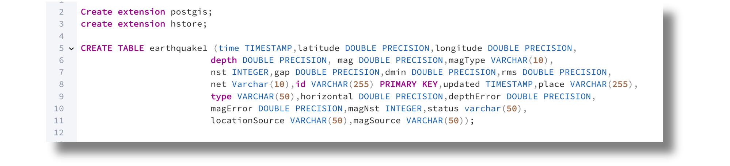
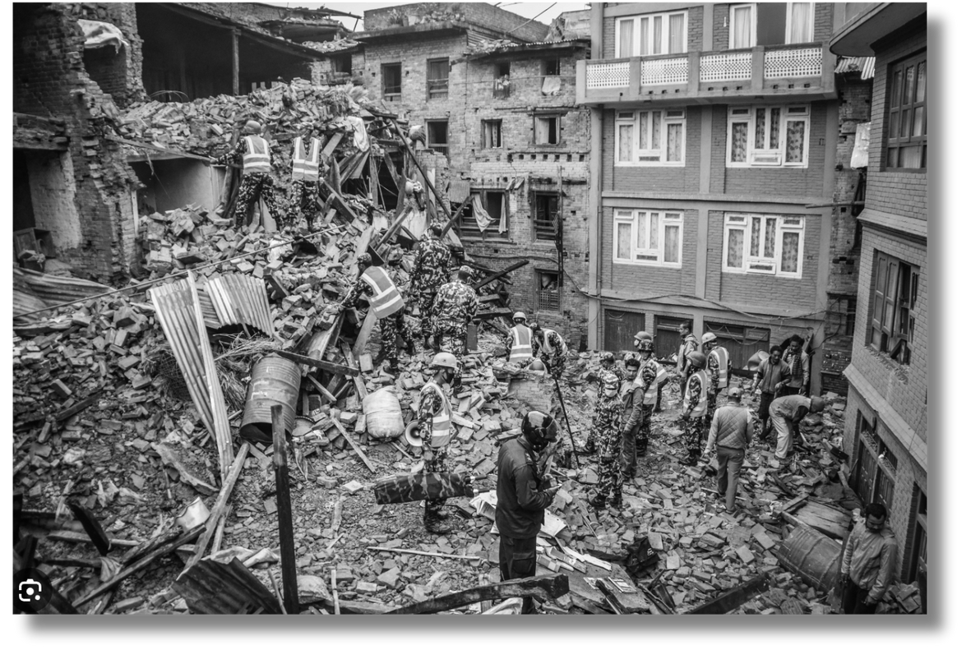
Create Table

Slide 6
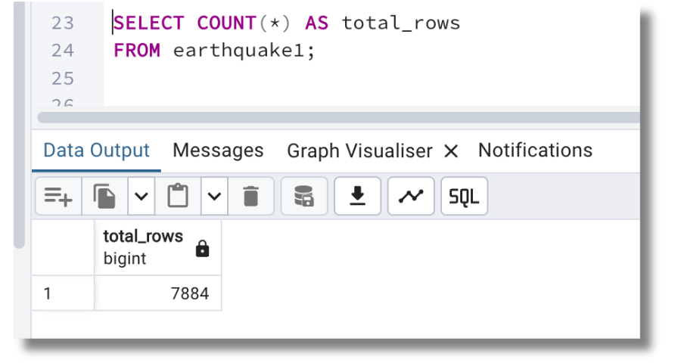
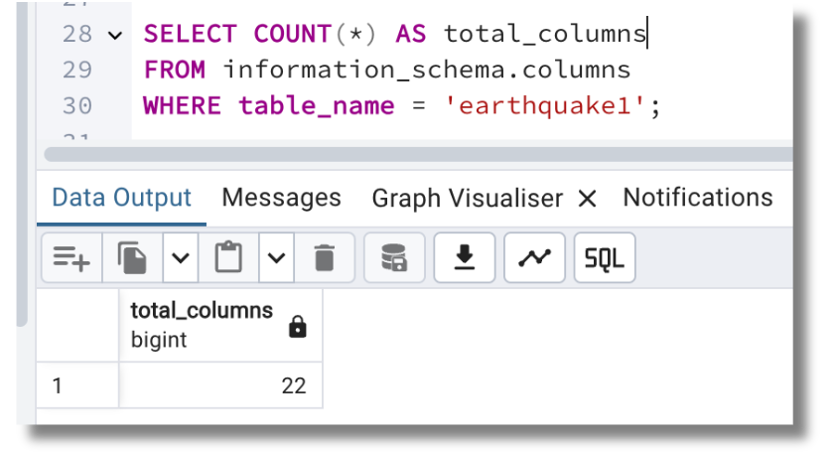
COUNT ROWS |COLUMNS
UTILIZED THE SQL COUNT() FUNCTION TO DETERMINE THE TOTAL NUMBER OF ROWS IN THE TABLE
GET TOTAL NUMBER OF COLUMNS FROM INFORMATION_SCHEMA

Slide 7
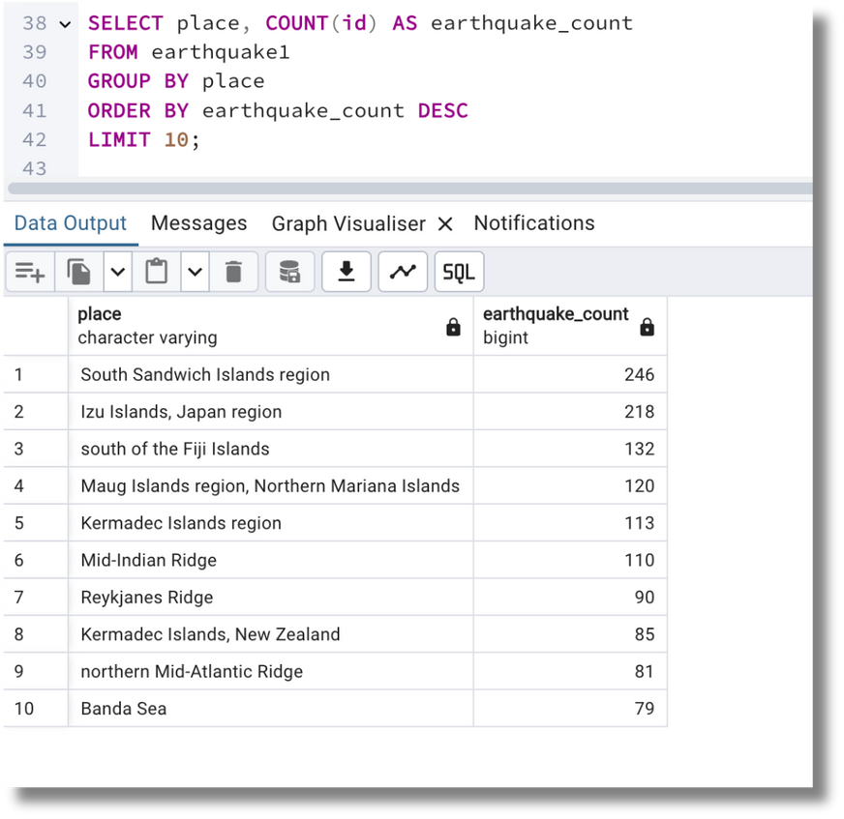
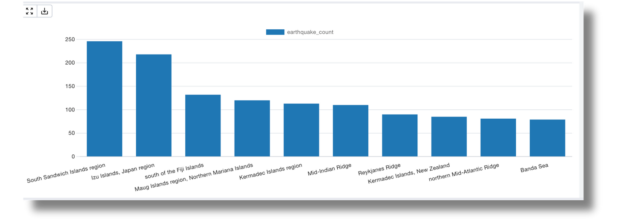
Top Regions
The region with the highest earthquake count is South Sandwich Islands with 246 earthquakes and 2nd highest is Izu Islands in Japan with 218 earthquakes

Slide 8
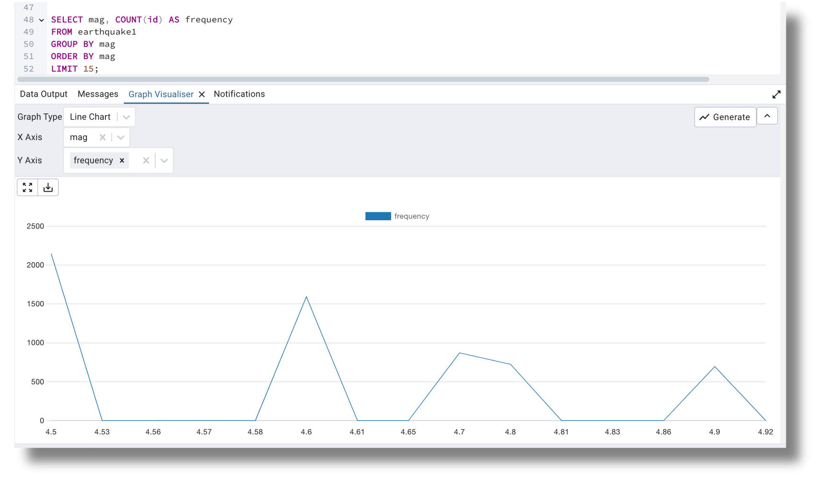
Analyzing Earthquake Magnitude Distribution
Understanding the frequency of different magnitudes

Slide 9
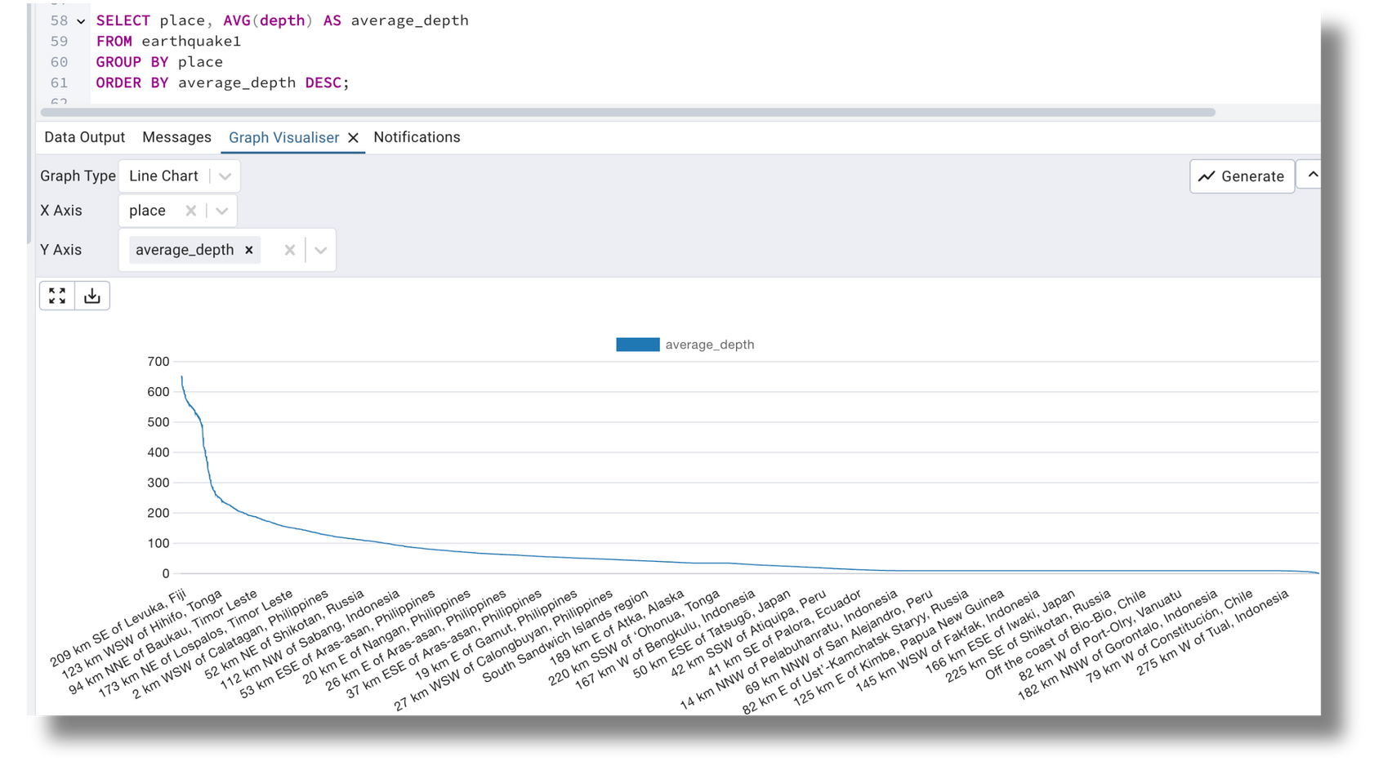
Average Depth of Earthquakes by Region
Calculating the average depth of earthquakes for each region to understand the typical depth at which earthquakes occur

Slide 10
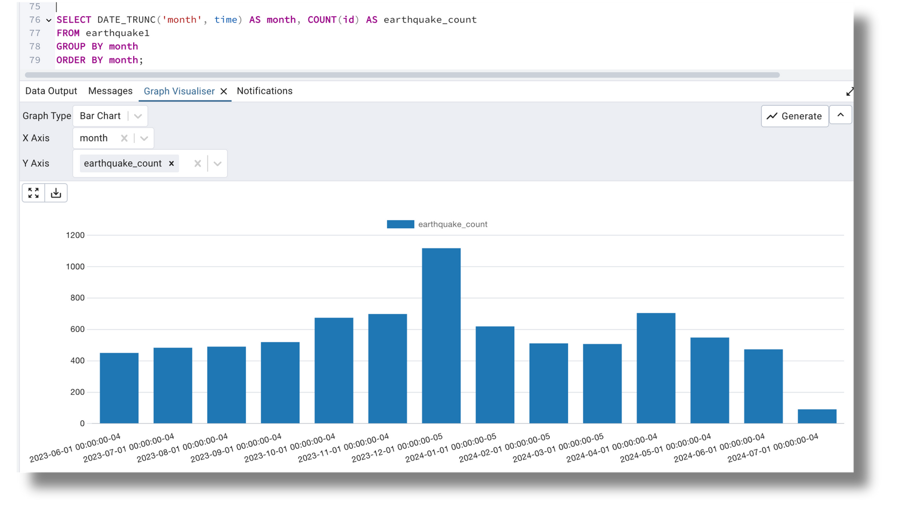
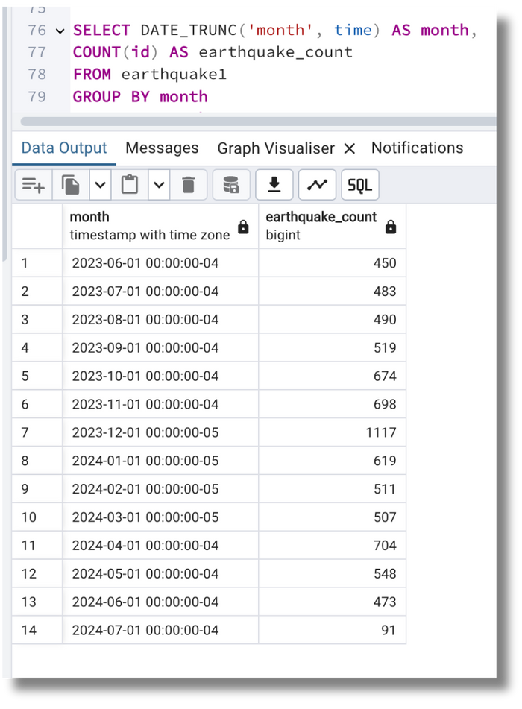
MONTHLY EARTHQUAKE TREND
Examined the trend of earthquakes over time on a monthly basis. December 23 had 1117 earthquakes followed by April 2024 with 704 and October 23 with 698 counts

Slide 11
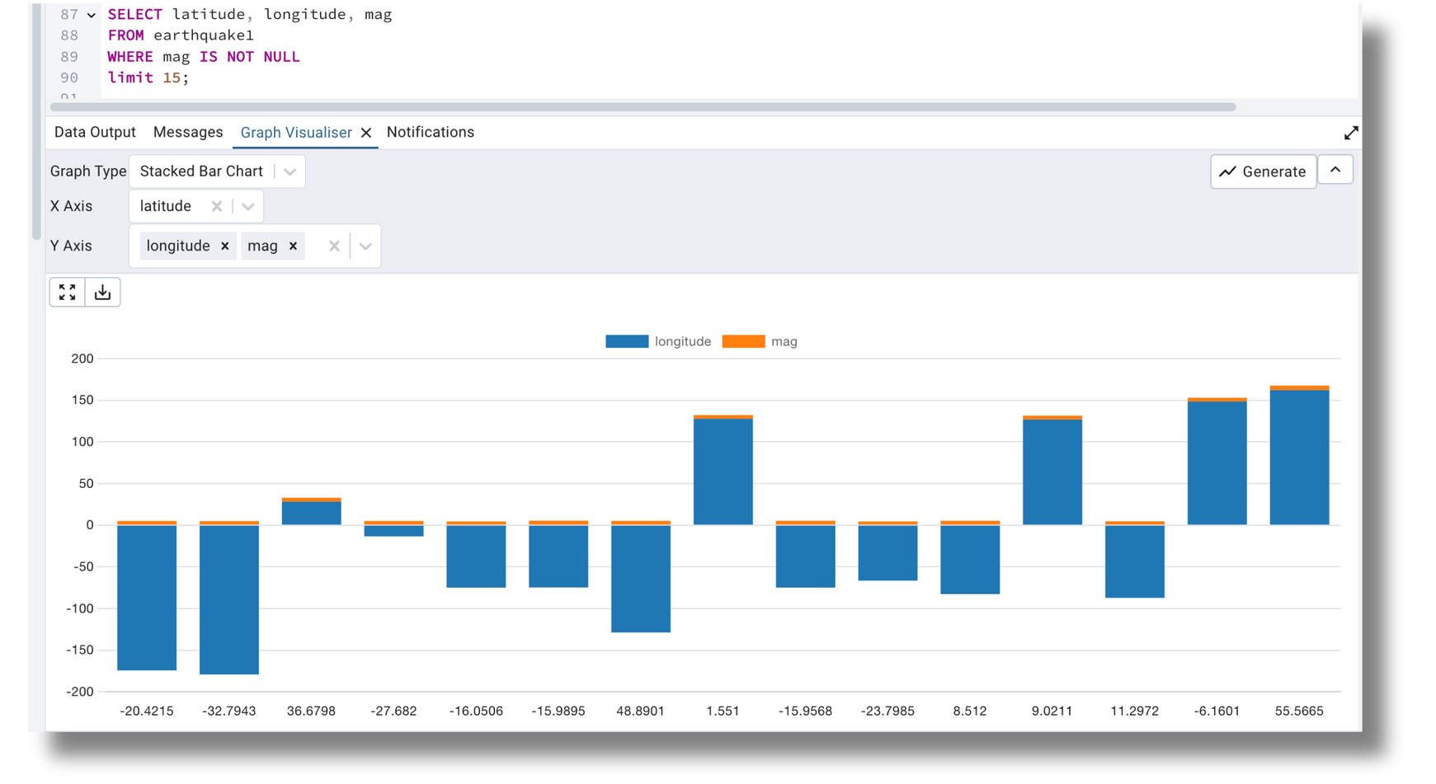
Magnitude vs Geographical Distribution
Analyze the distribution of earthquake magnitudes across different latitude and longitude ranges

Slide 12
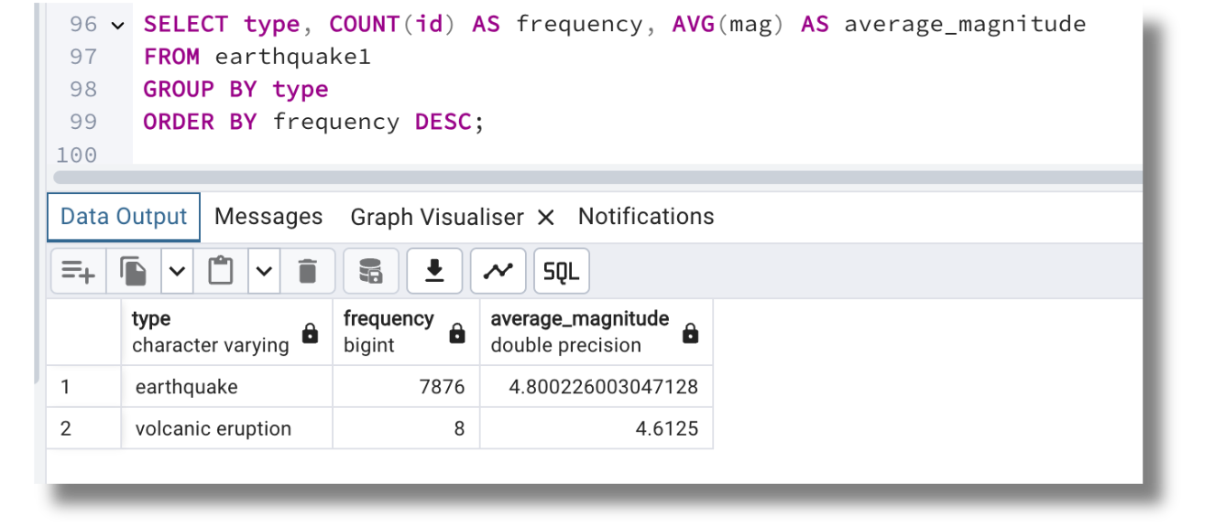
High-Risk Earthquake
Identify the types of earthquakes that occur most frequently and their average magnitude

Slide 13
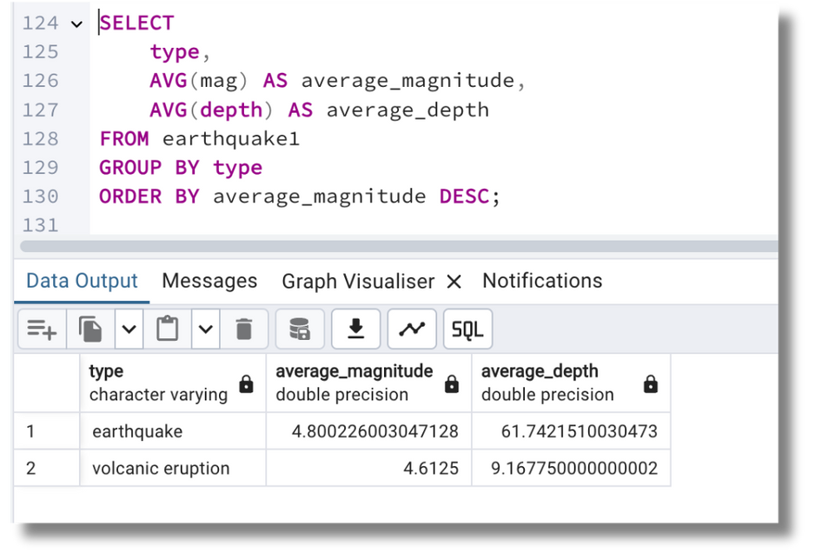
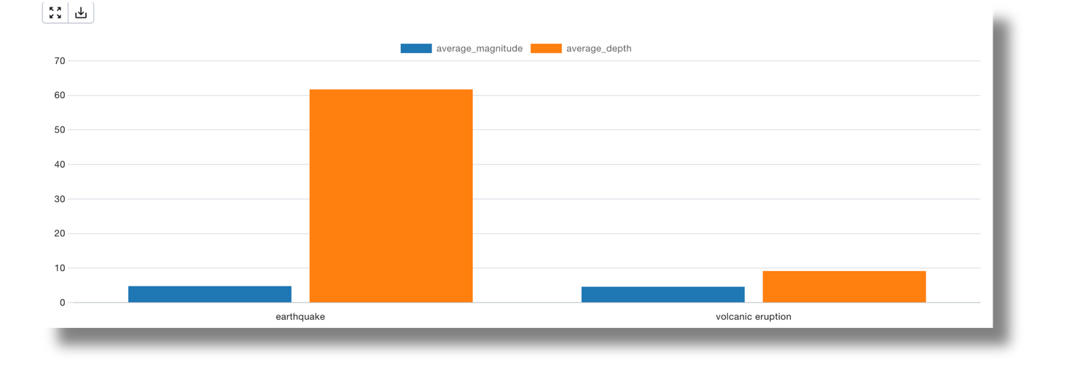
Average Magnitude and Depth by Earthquake Type
calculate the average magnitude and average depth for each type of earthquake

Slide 14
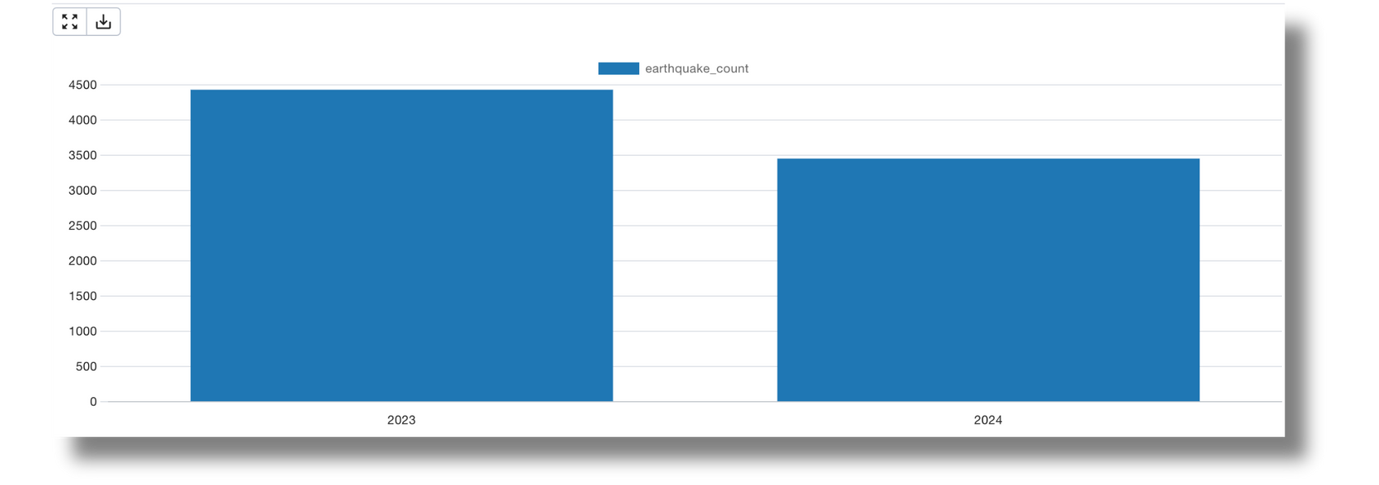
Frequency of Earthquakes by Year
The number of earthquakes that occurred each year.

Slide 15
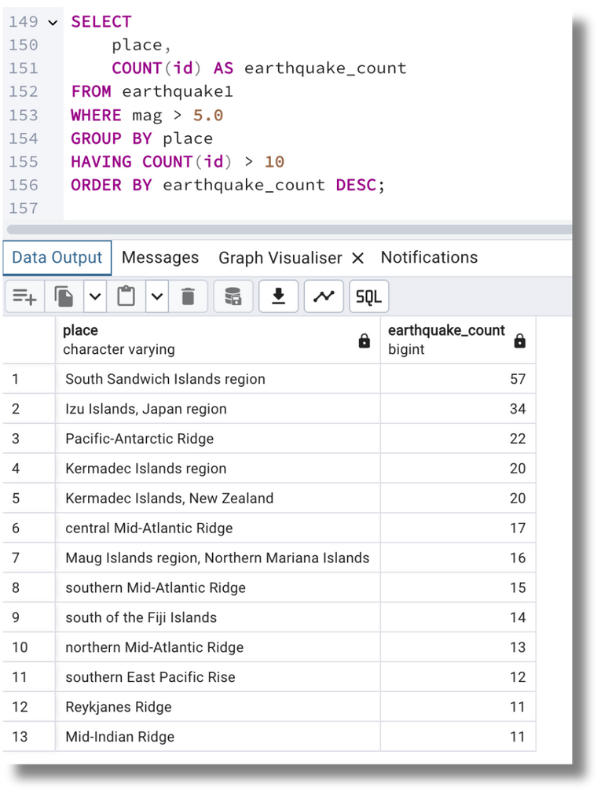
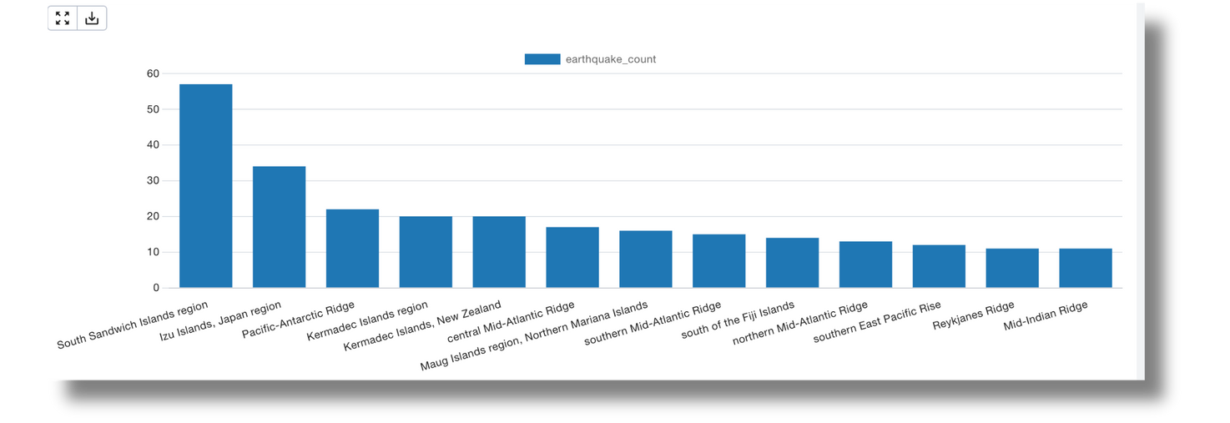
High-Risk Areas Based on Magnitude Thresholds
Identify regions that frequently experience earthquakes with a magnitude greater > 5.0

Slide 16
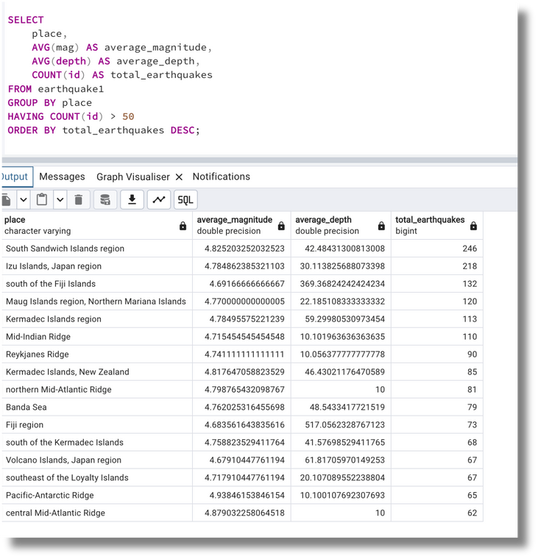
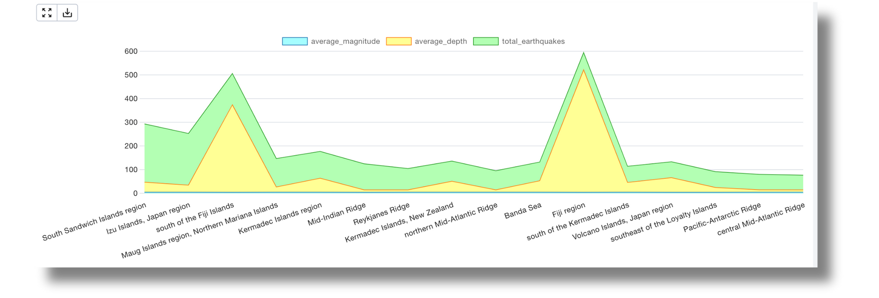
Compare AVG Magnitude, Depth, and total number of earthquakes for different regions

Slide 17
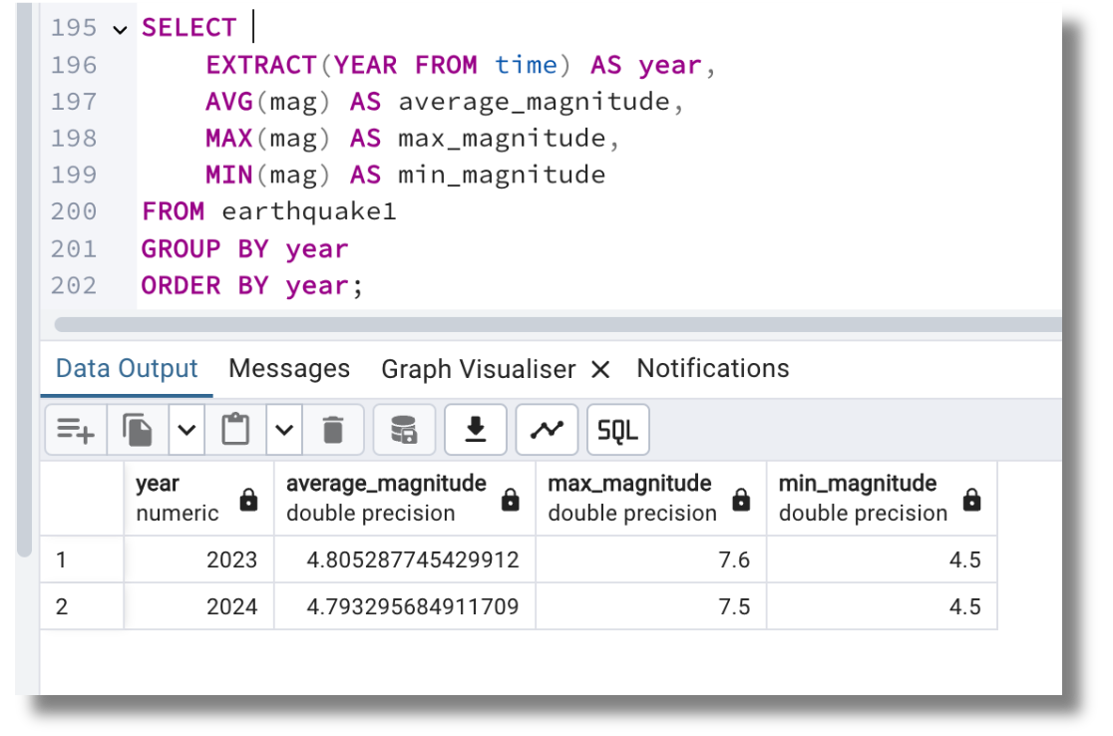
Severity of Earthquakes Over Time
Analyze how the severity (measured by magnitude) of earthquakes has changed over the years

Slide 18
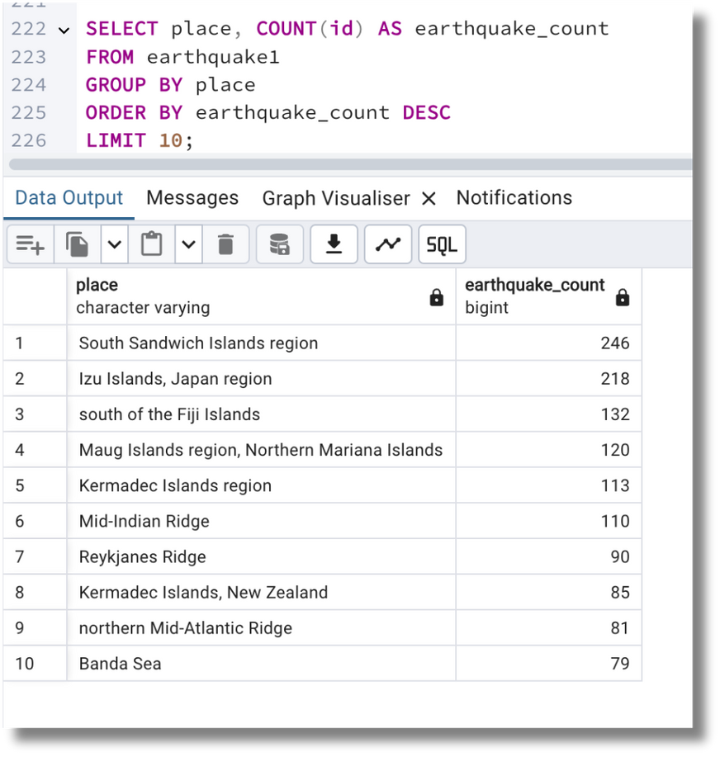
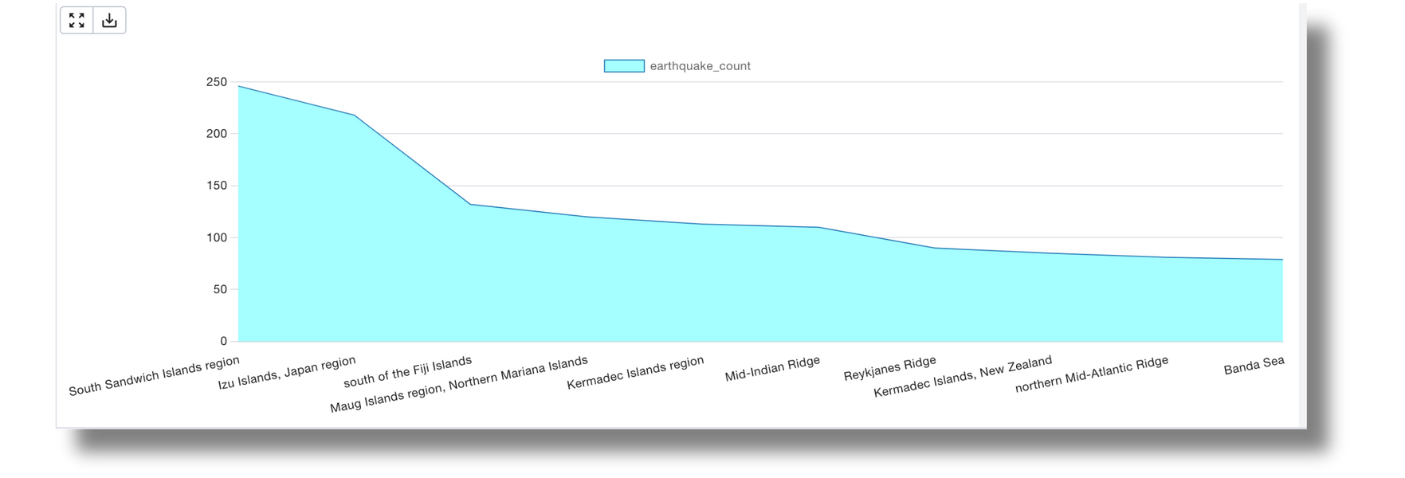
Regions Most Affected by Earthquakes

Slide 19
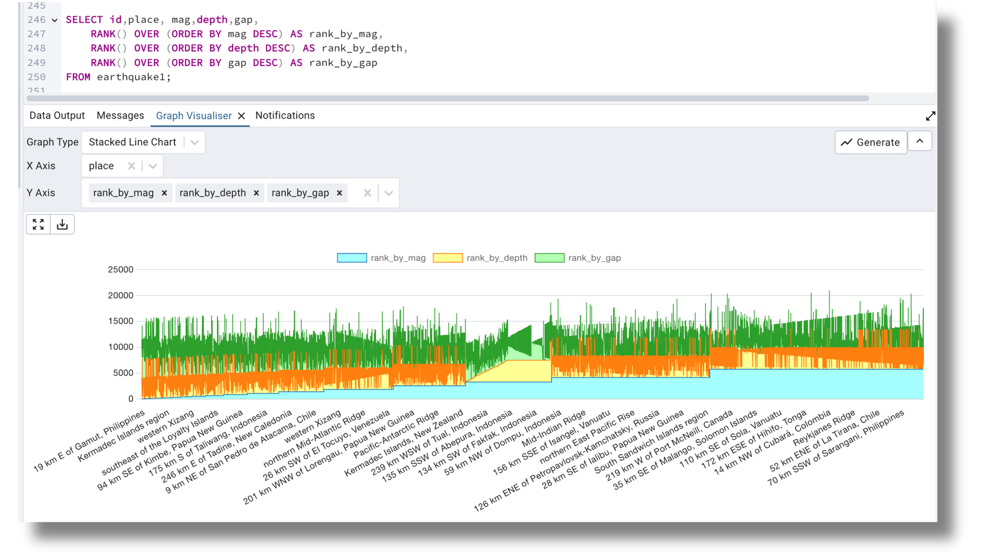
Rank Earthquakes by Magnitude, Depth, and Gap

Slide 20
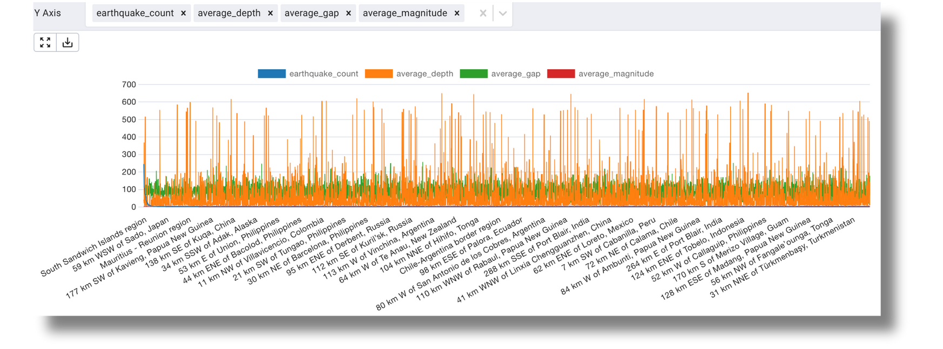
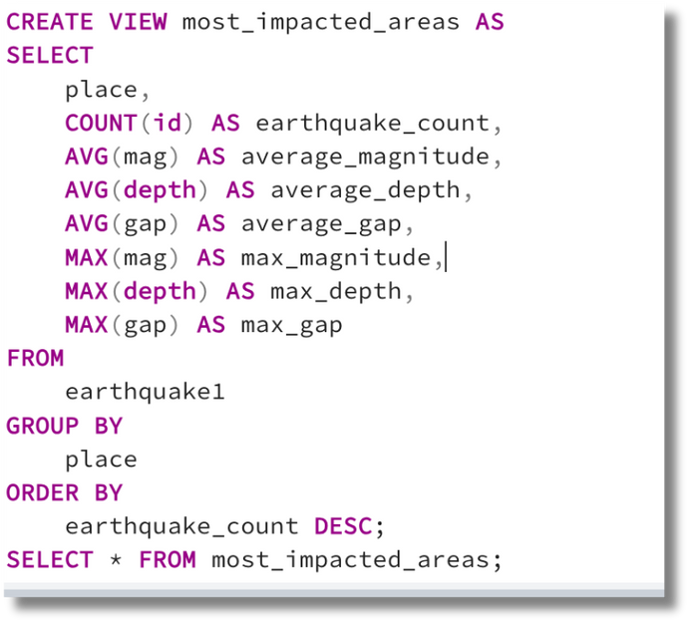
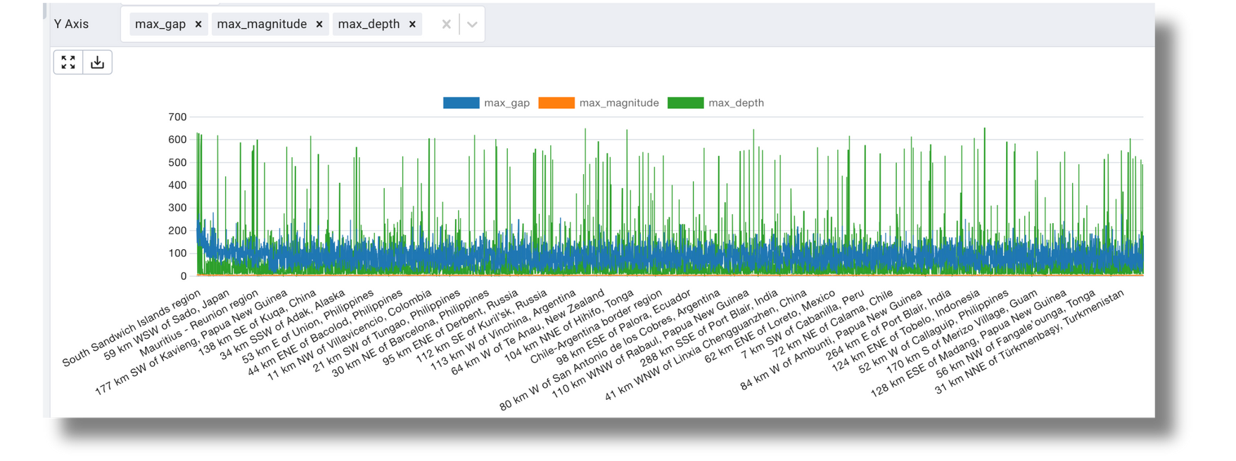
Create View for Most Impacted Areas

Slide 21
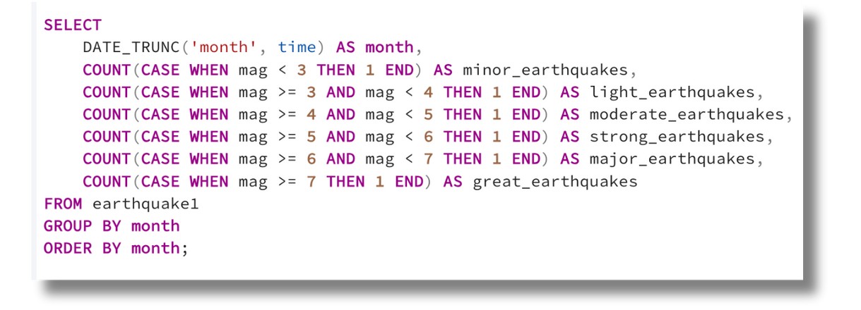
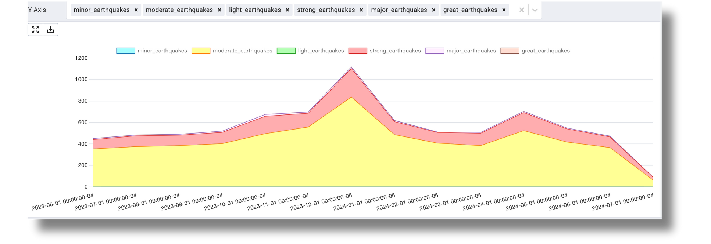
Number of earthquakes each month, classified by magnitude categories

Slide 22
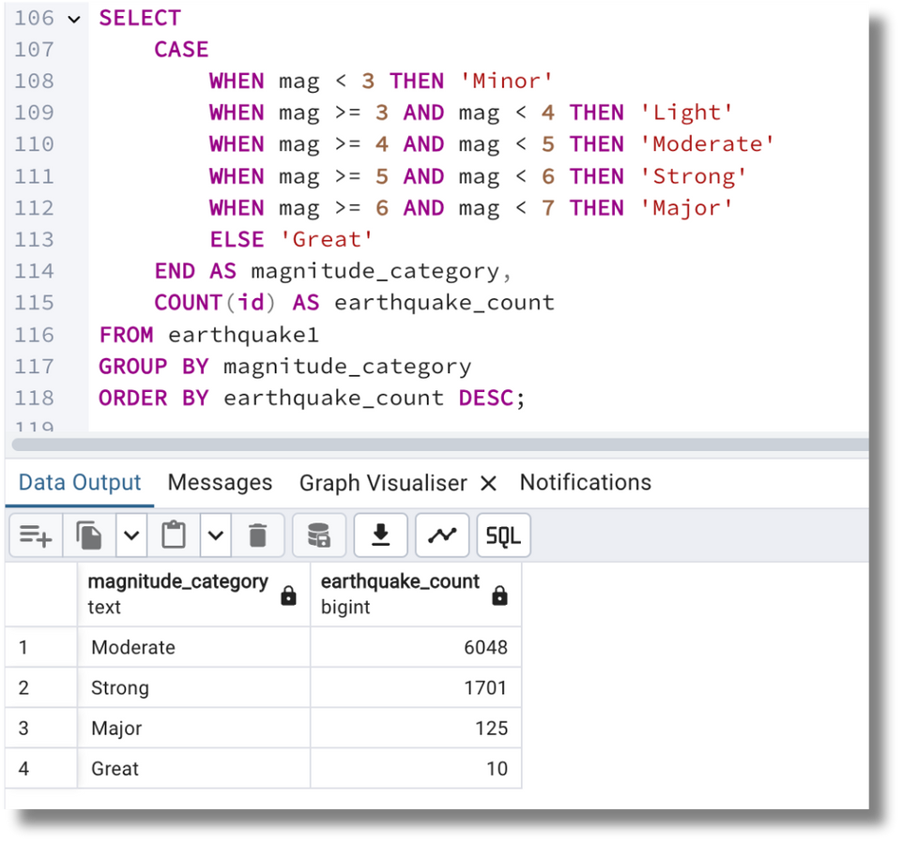
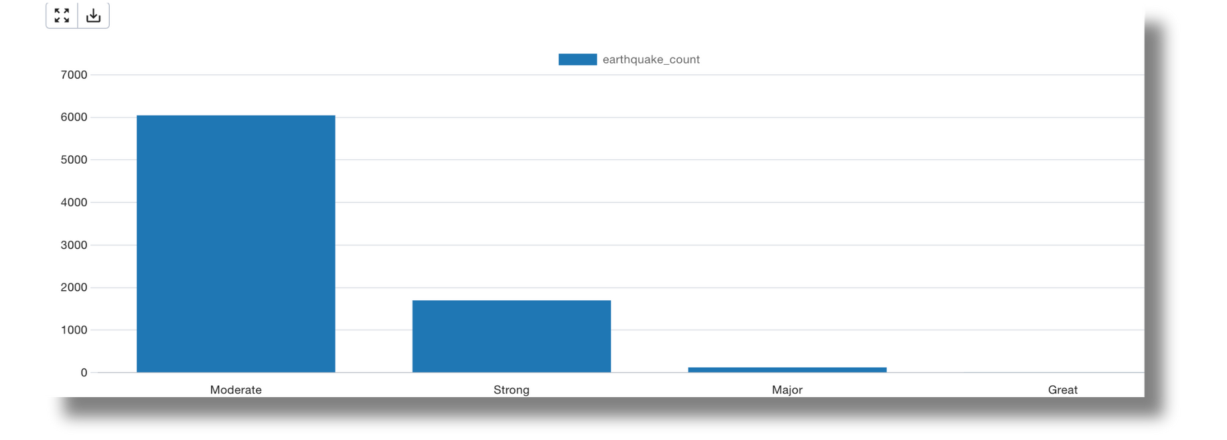
Classify Earthquake Magnitudes.
Classify earthquakes into categories such as minor, light, moderate, strong, major, and great, and count the number of earthquakes in each category

Slide 23
Results & Key Findings
By leveraging detailed data analysis, we have identified key regions affected by earthquakes, understood the magnitude and depth distribution, and observed temporal trends. These insights are crucial for informed decision-making and developing targeted strategies for earthquake preparedness and risk mitigation. Implementing the recommendations can help in reducing the impact of earthquakes and enhancing the resilience of communities in high-risk areas.
Regions Most Affected:
The top regions with the highest earthquake occurrences were identified as South Sandwich Islands region and Izu Islands, Japan. These regions experienced significantly more earthquakes compared to others, indicating high seismic activity zones
Magnitude Analysis:
Most earthquakes were classified as Minor to Moderate, with fewer instances of Strong, Major, and Great earthquakes. This indicates that while earthquakes are frequent, extremely high-magnitude earthquakes are relatively rare.
Depth Analysis:
The average depth of earthquakes varied by region, with some areas experiencing deeper seismic activities than others. This information is crucial for understanding the underlying geological processes and potential risks.

Slide 24
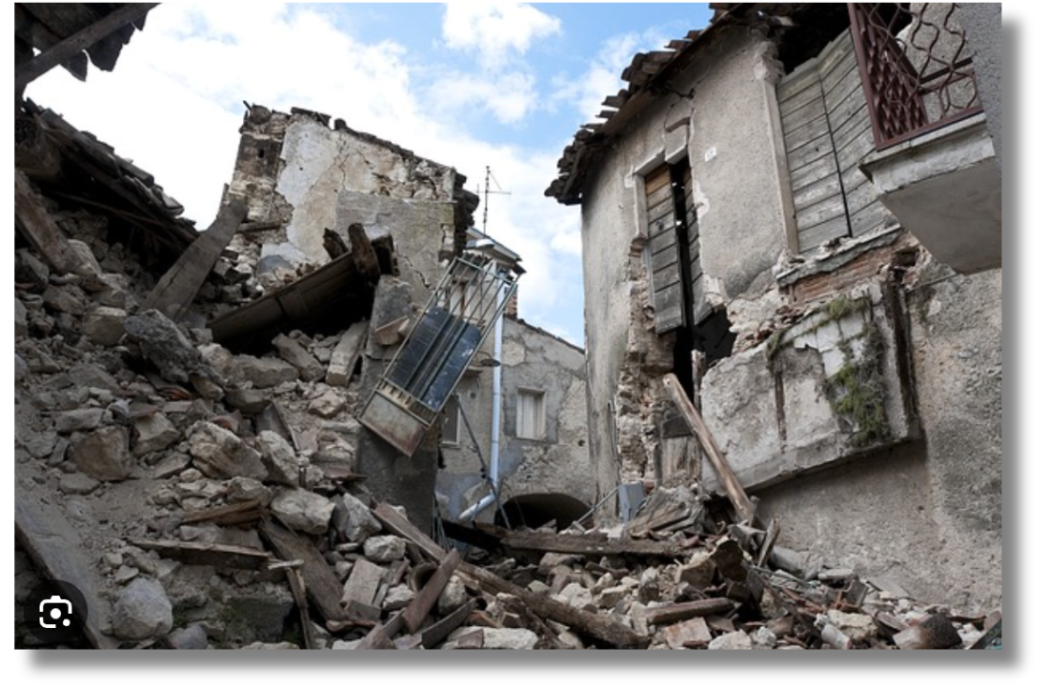
Thank You for Reading
for complete notebook , please check out my github account
https://github.com/Inderjito

